Slide 1

P70 - NLP Email Template
Team 6
Members
Azhar Kaleem Abul Aarif Shaikh Chodisetti. Veera Subrahmanyam Pratti Sai Keerthi Susmita Sunil Ranpise Mutukundu Bala Vishnuvardhan Reddy Shaik Mothaduvari Mahammad Irfan Tanguturi Venkata Prathyusha

Slide 2
Problem Statement
Having to write multiple mails for different responses to various entities and services from the business.
No standard responses, lot of variation and unorganized / non-standard means of response might lead to error or mistakes in responding.

Slide 3
Objective
Creating email templates search engine to prompt you on standard email templates to use for responding to a specific function / service in business with use of NLP
To get the nearest email template required by the user based on the key words specified by the user.

Slide 4
Methodology
Dataset
Search Engine
Search by keywords
Search by categories
Input statement
Select Category
Select from the list of results
Select title
Display Template

Slide 5
Data Collection
Web scraping data – “www.letters-home.com/”
Tools used – Beautiful Soup from bs4 and requests
Challenges – The above website contains letters instead of emails
Amount of Data – There are total 90 categories which contain a lot of letter samples. Filter out 54 categories removing all the unwanted categories.
Saving the data in the form .xls file after successful extraction

Slide 6
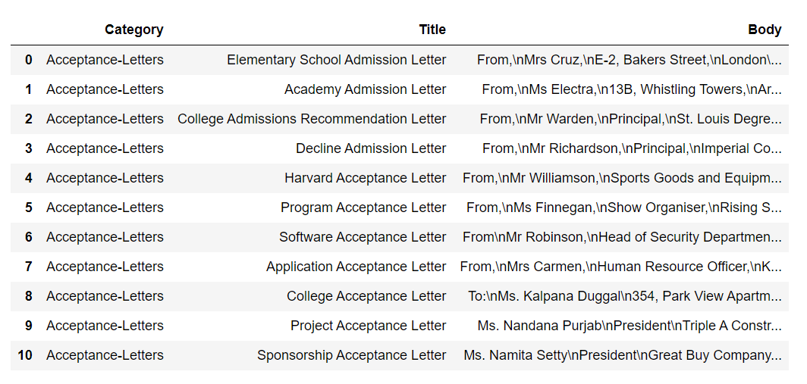

Slide 7
Data Preprocessing
Objectives –
Dropping null values
Replacing some words with their desired alternative
Adding a separate column which will contain tokens of the title column
Removing unwanted strings from the scraped email body
Preprocessing the title column (Removal of punctuation, Tokenization, Removal of stop words, lemmatization)
Applying Named Entity Recognition to Email Body to replace Named Entities with their respective tags
Tools used –
Regular Expressions for removing punctuations
nltk.word_tokenize() for tokenization
nltk.stem.WordNetLemmatizer() for lemmatization
'en_core_web_sm’ model from space for named entity recognition

Slide 8
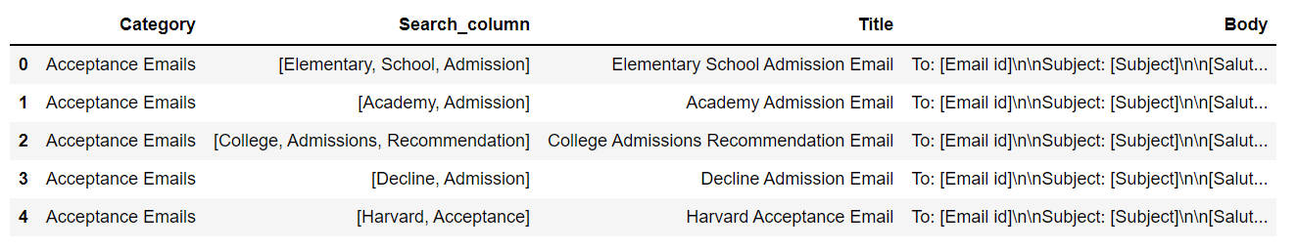

Slide 9
EDA

Slide 10
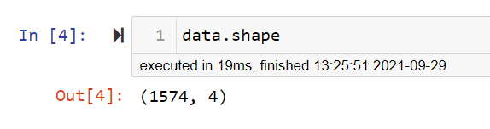
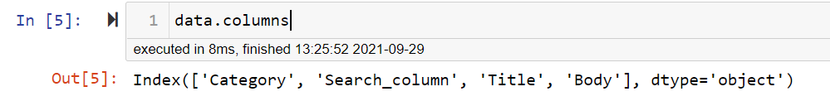
Dataset contains 1574 entries and 4 columns
Dataset contains 4 columns namely 'Category’, ‘Search_column’, 'Title' and 'Body'
Dataset altogether consists of 1574 Email templates

Slide 11
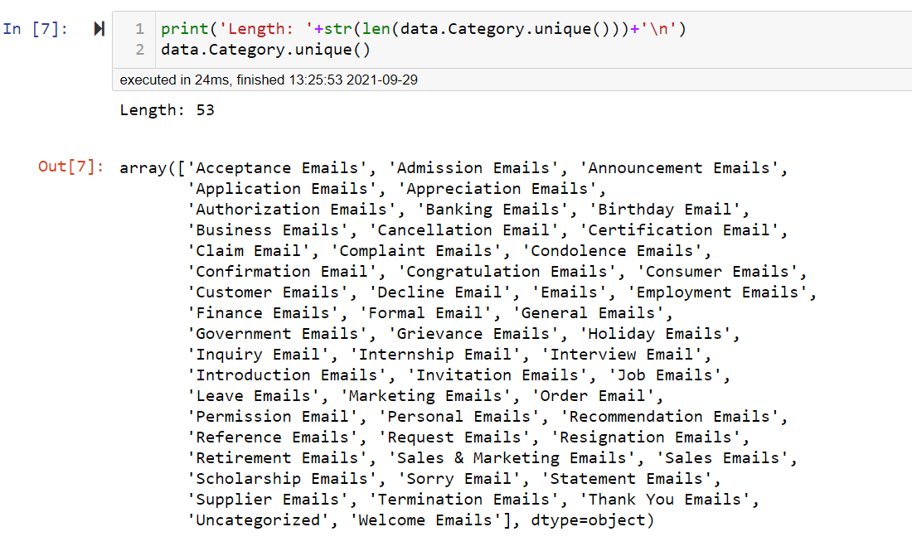
As we can see that there are 53 Categories as shown above.
The title column shows the title of each Email
The Search_column consists of the tokens from the title column for matching the keywords.
The Body column consists of templates of the email.

Slide 12
Working

Slide 13
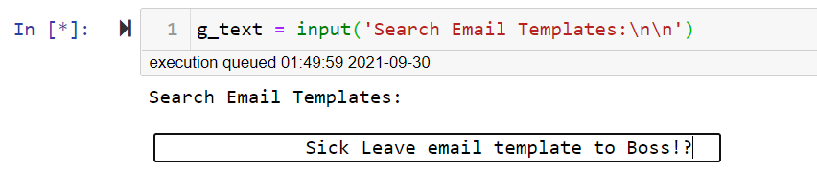
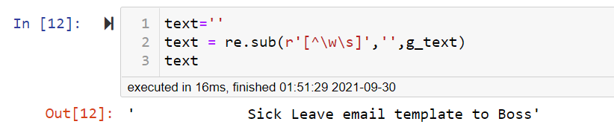
Input term
Removing punctuations using regular expressions

Slide 14
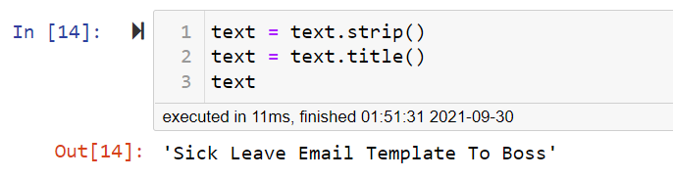
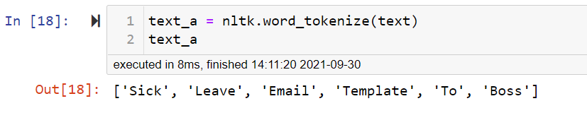
Removing extra spaces from start and end of the string
Tokenization

Slide 15
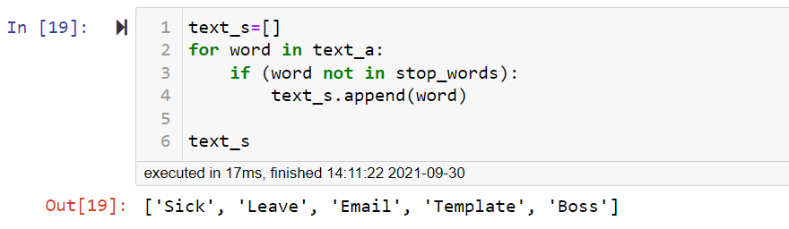
Removing stop words from the list of tokens
• Importing stop words from nltk corpus

Slide 16
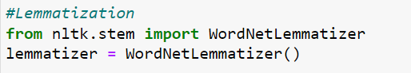
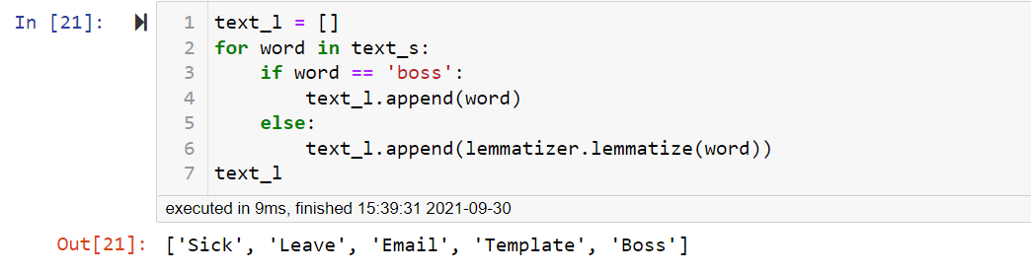
Performing Lemmatization

Slide 17
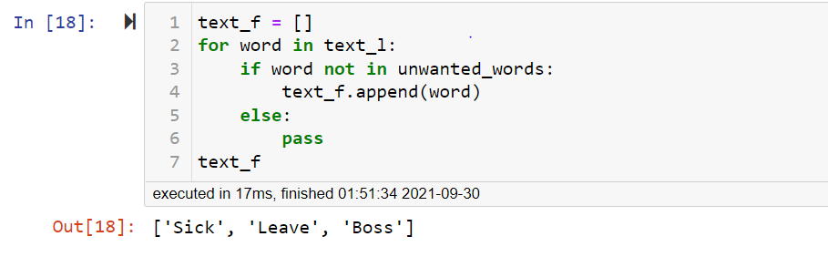
Removing unwanted words
Final Keywords

Slide 18
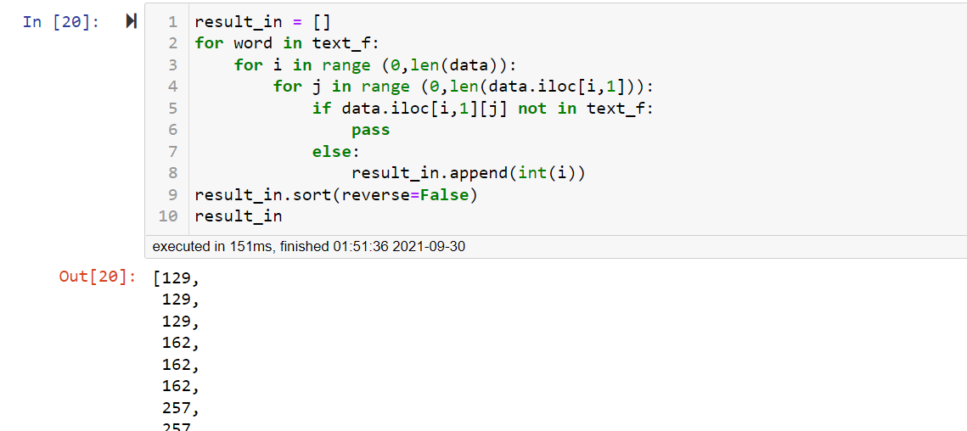
Searching keywords in the Search_column
The above lines return the index values where the keywords match

Slide 19
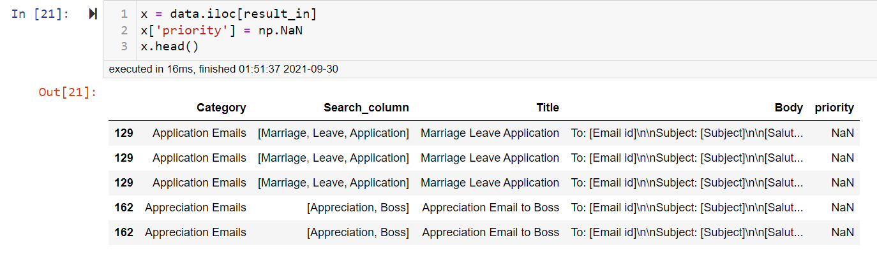
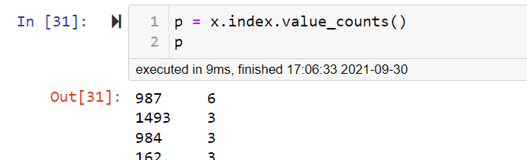
Adding a priority column to get the best possible match in the results
Priority value = Value Count of Index values in result

Slide 20
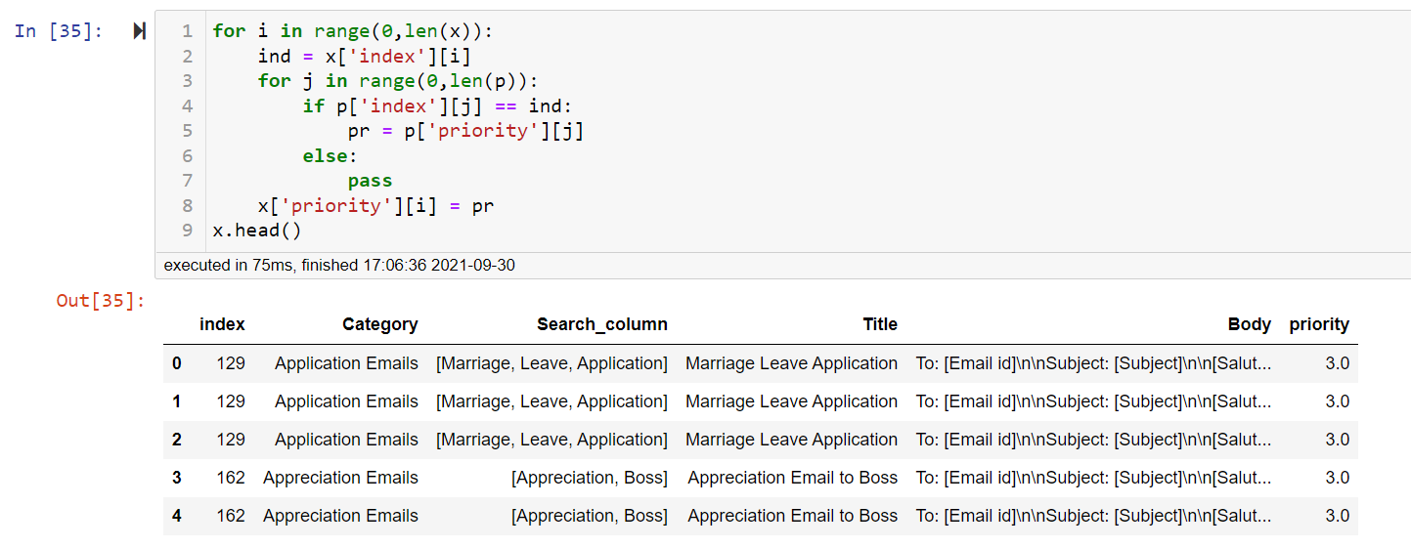
Assigning priority values against their respective indexes

Slide 21
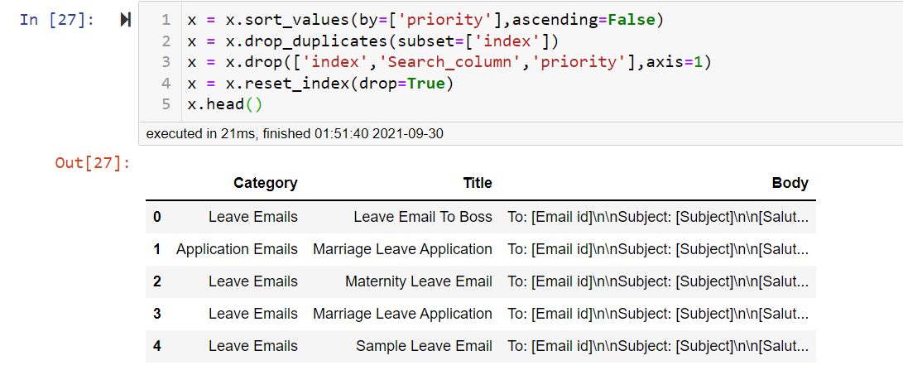
Sorting results by priority
First Row in the results is the most relevant match

Slide 22
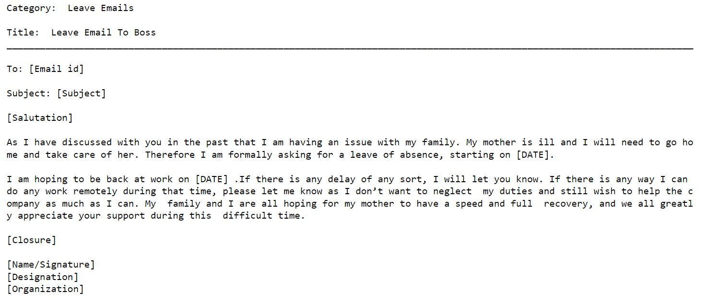

Slide 23
Deployment

Slide 24

Flask –
Backend framework that deploys apps using python
Advantages – Scalable, Highly customizable
Disadvantages – More learning required to take full advantage, requires front end development,
Streamlit –
Framework to create interactive data apps
Advantages – Easy to implement, No routing, No front end development needed
Disadvantages – Not Scalable, Cannot customize front end components

Slide 25
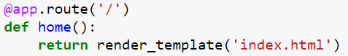
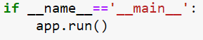
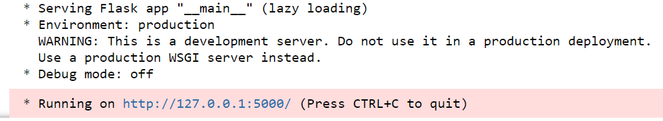
Setting up Flask App
First we import the necessary libraries:
from flask import Flask, render_template, request
Then initialize the app:
We can navigate through the app using ‘route’ command:
Running the app:
We can visit the Webpage by clicking on the highlighted URL
We can multiple routes in the app according to our requirement

Slide 26
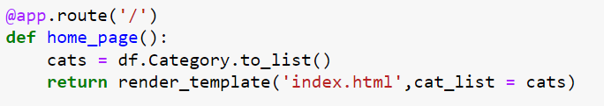
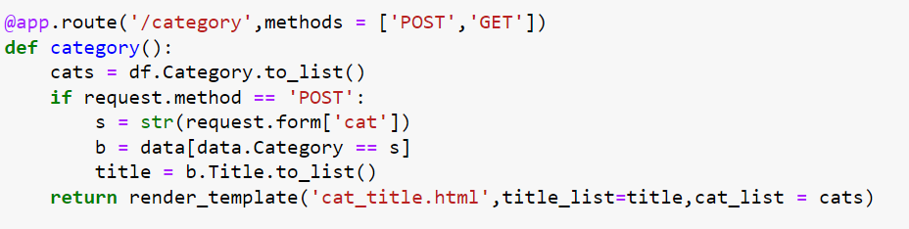
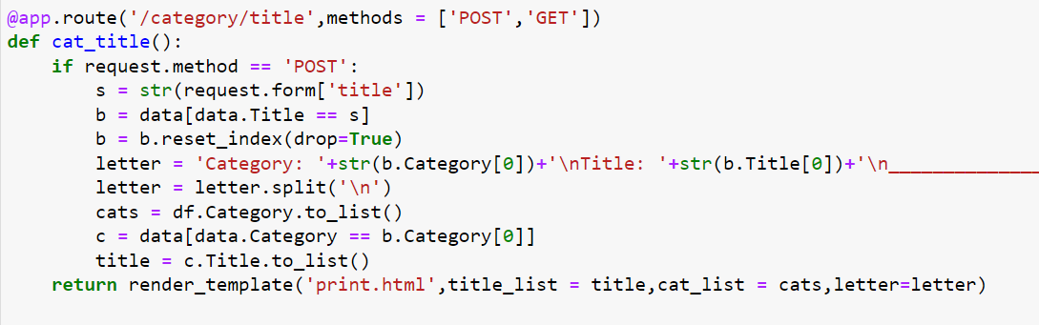
Route samples
Home Page

Slide 27
Deployment Snippets

Slide 28
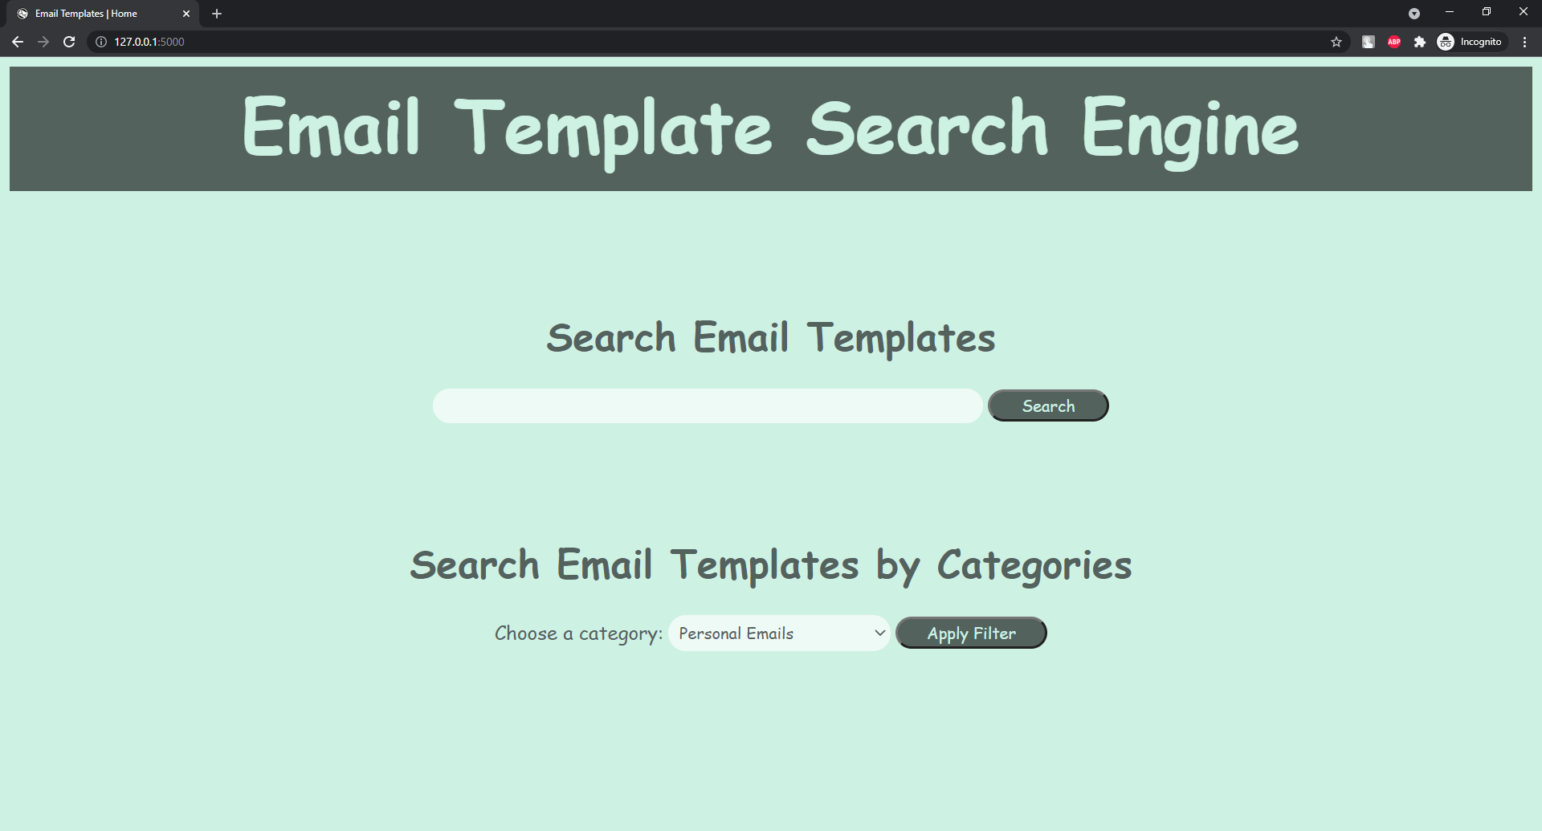

Slide 29
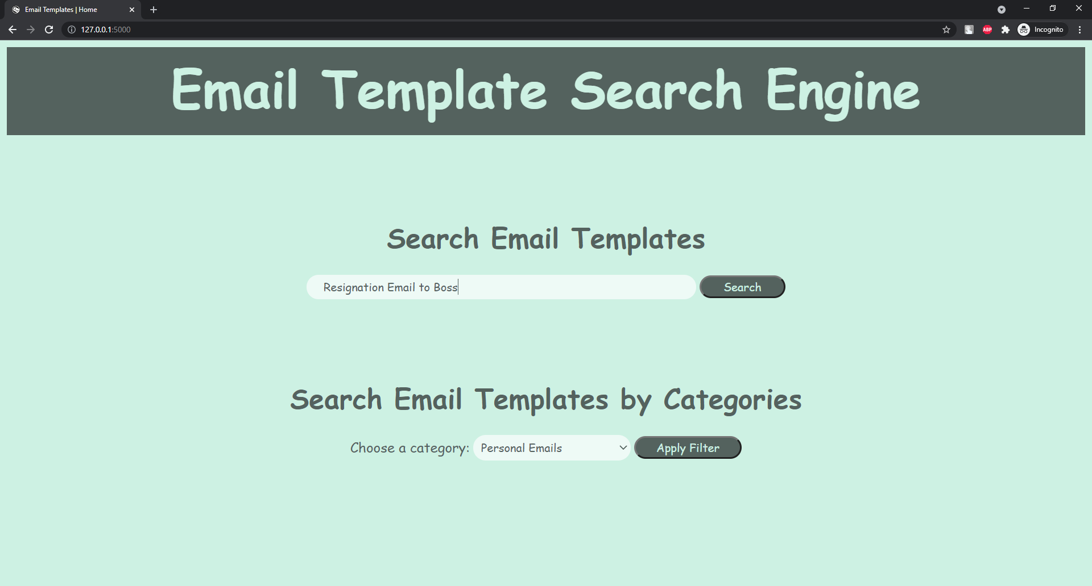
Type in the search term

Slide 30
Click Search

Slide 31
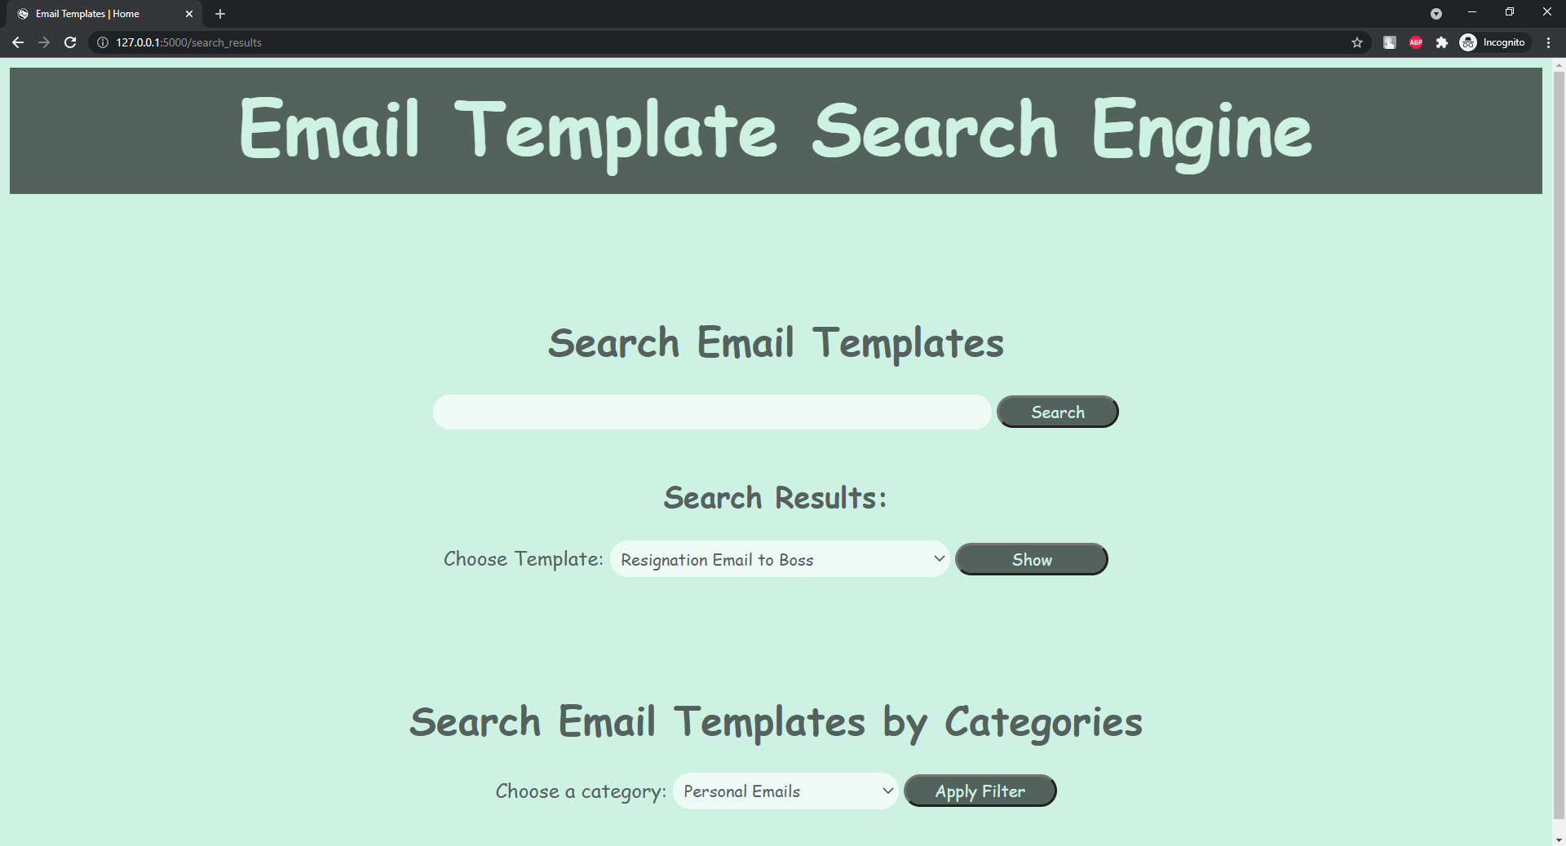
Search Results

Slide 32
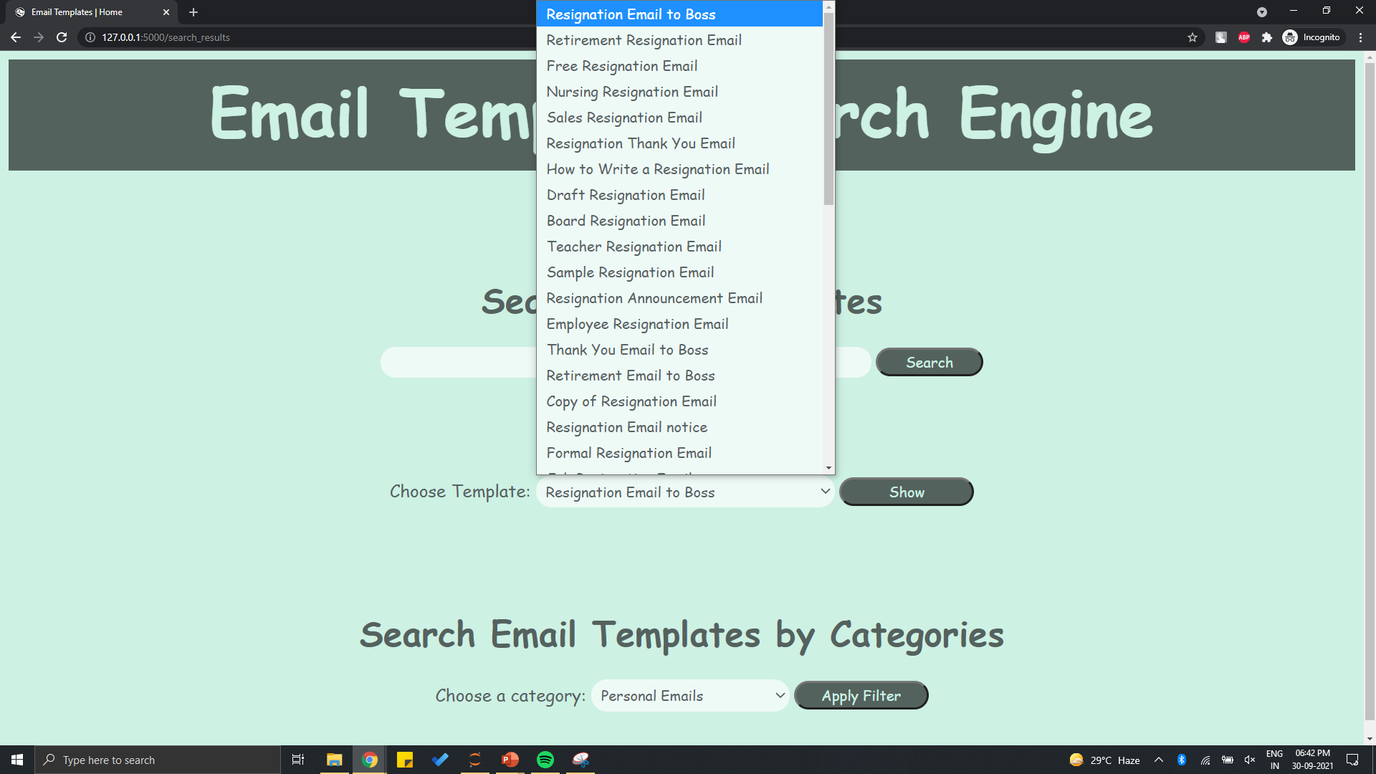
Select from the given Search Results

Slide 33
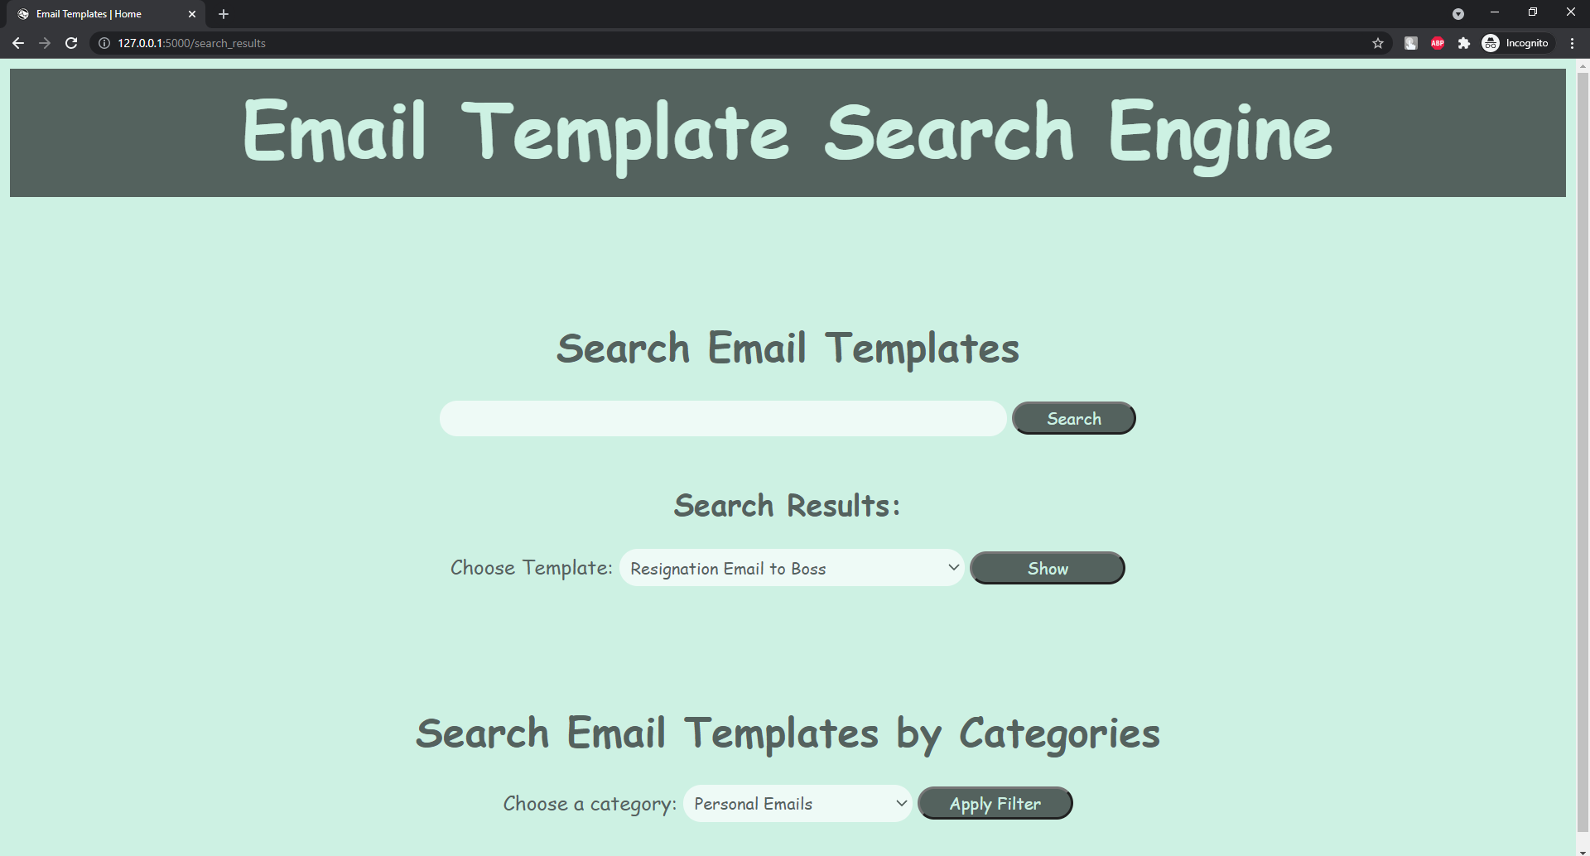
Click Show

Slide 34
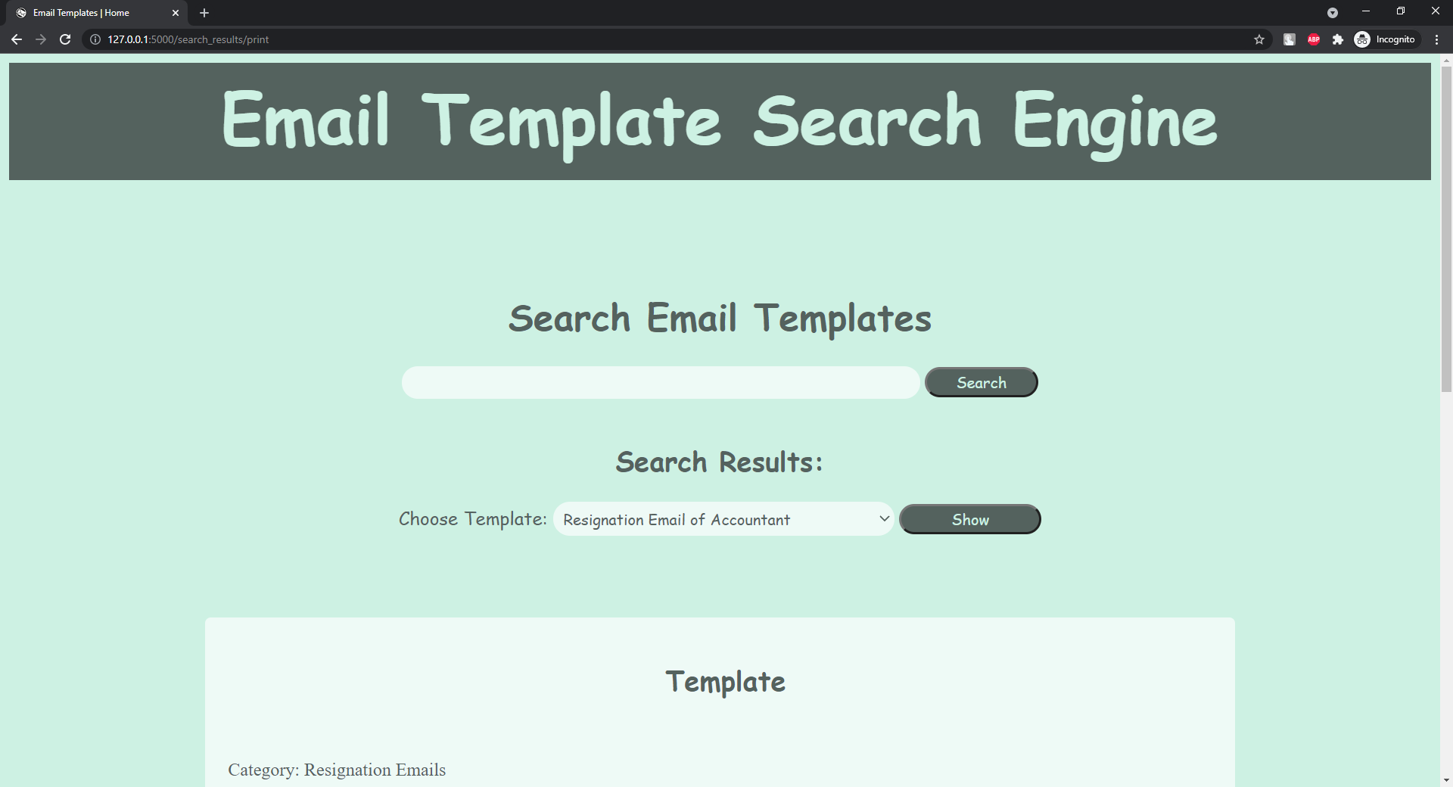
Template is displayed

Slide 35
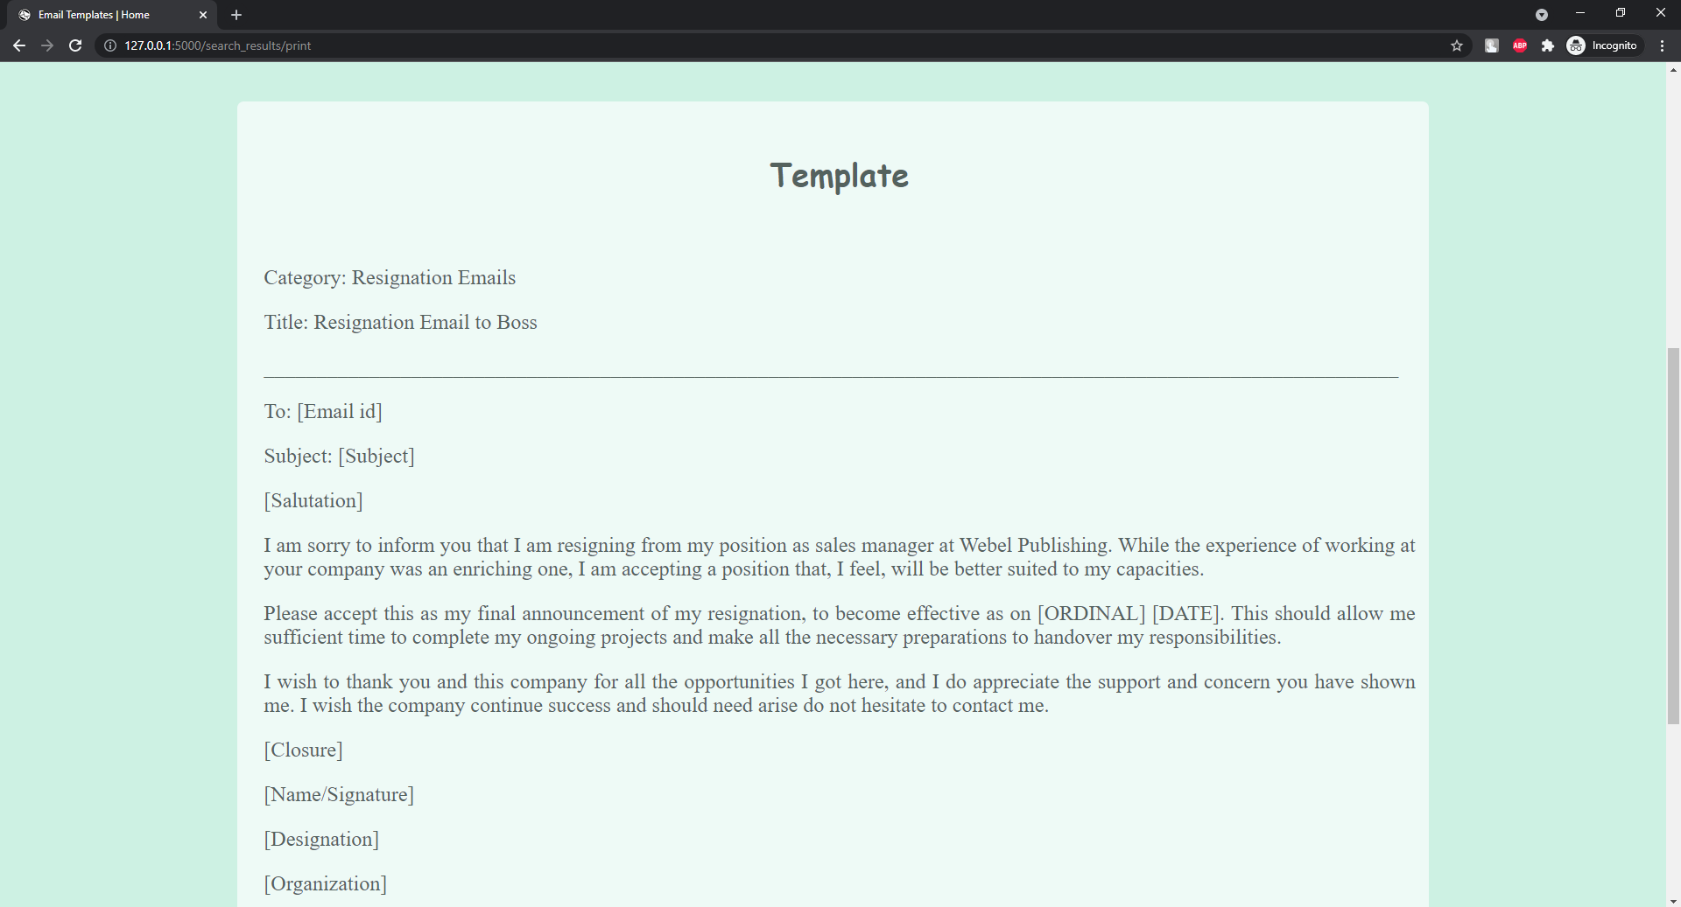

Slide 36
Choose Category

Slide 37
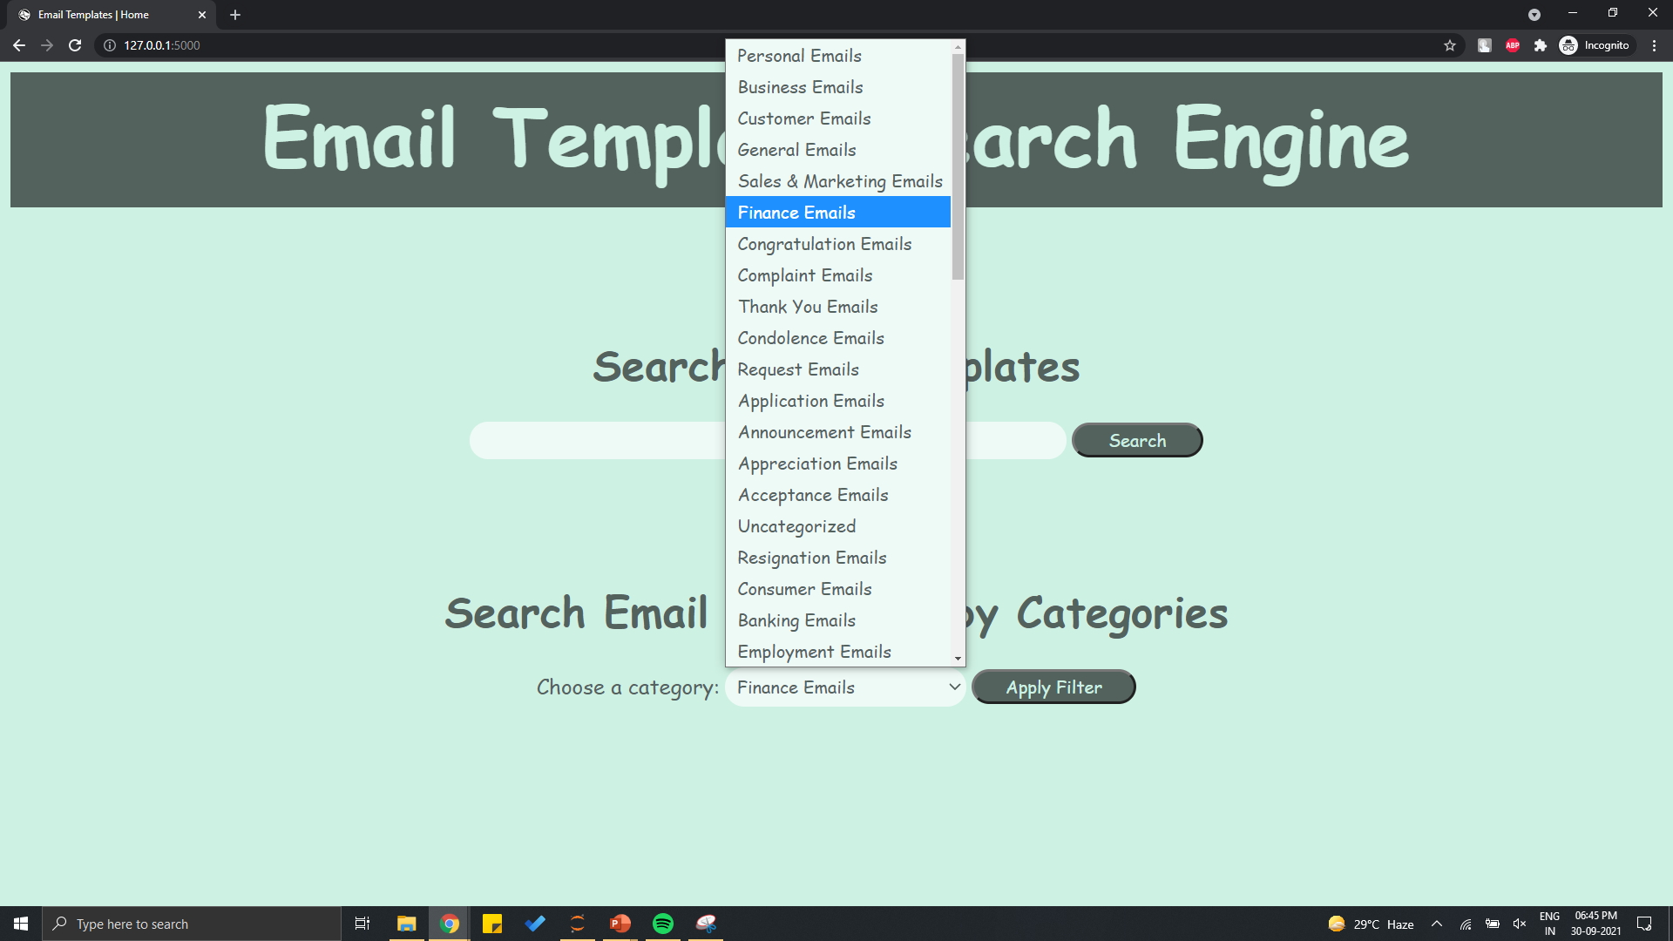
Choose from the list of category
Click Apply Filter

Slide 38
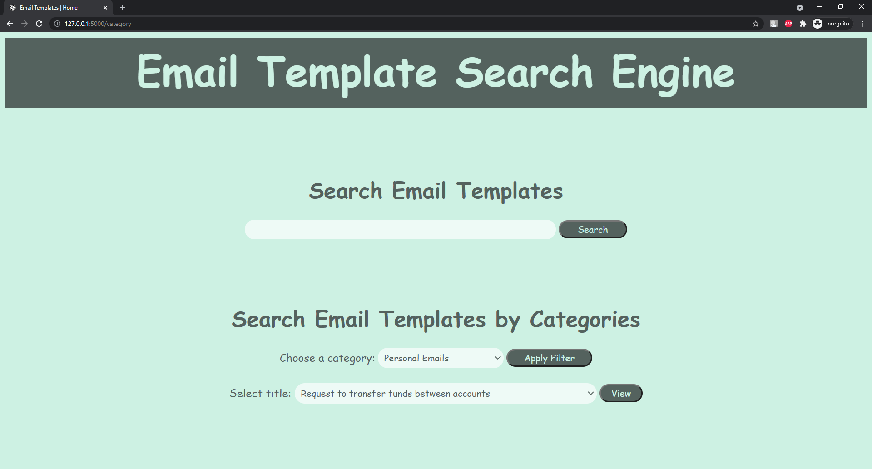
Choose Title

Slide 39
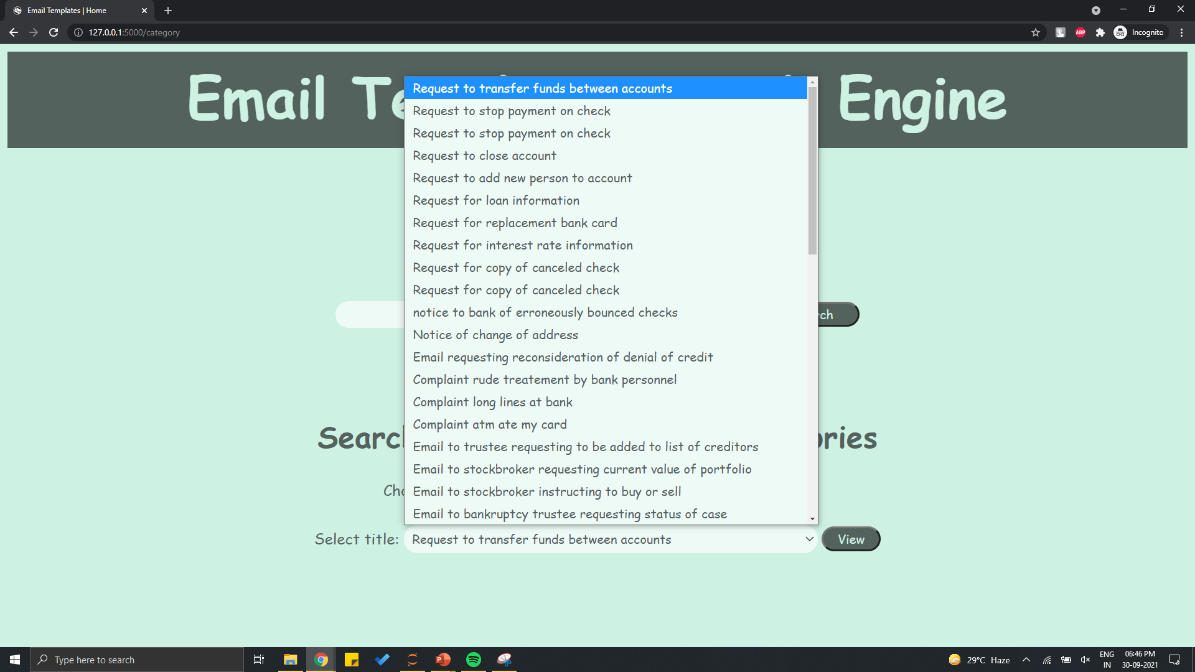
Choose from the list of titles

Slide 40
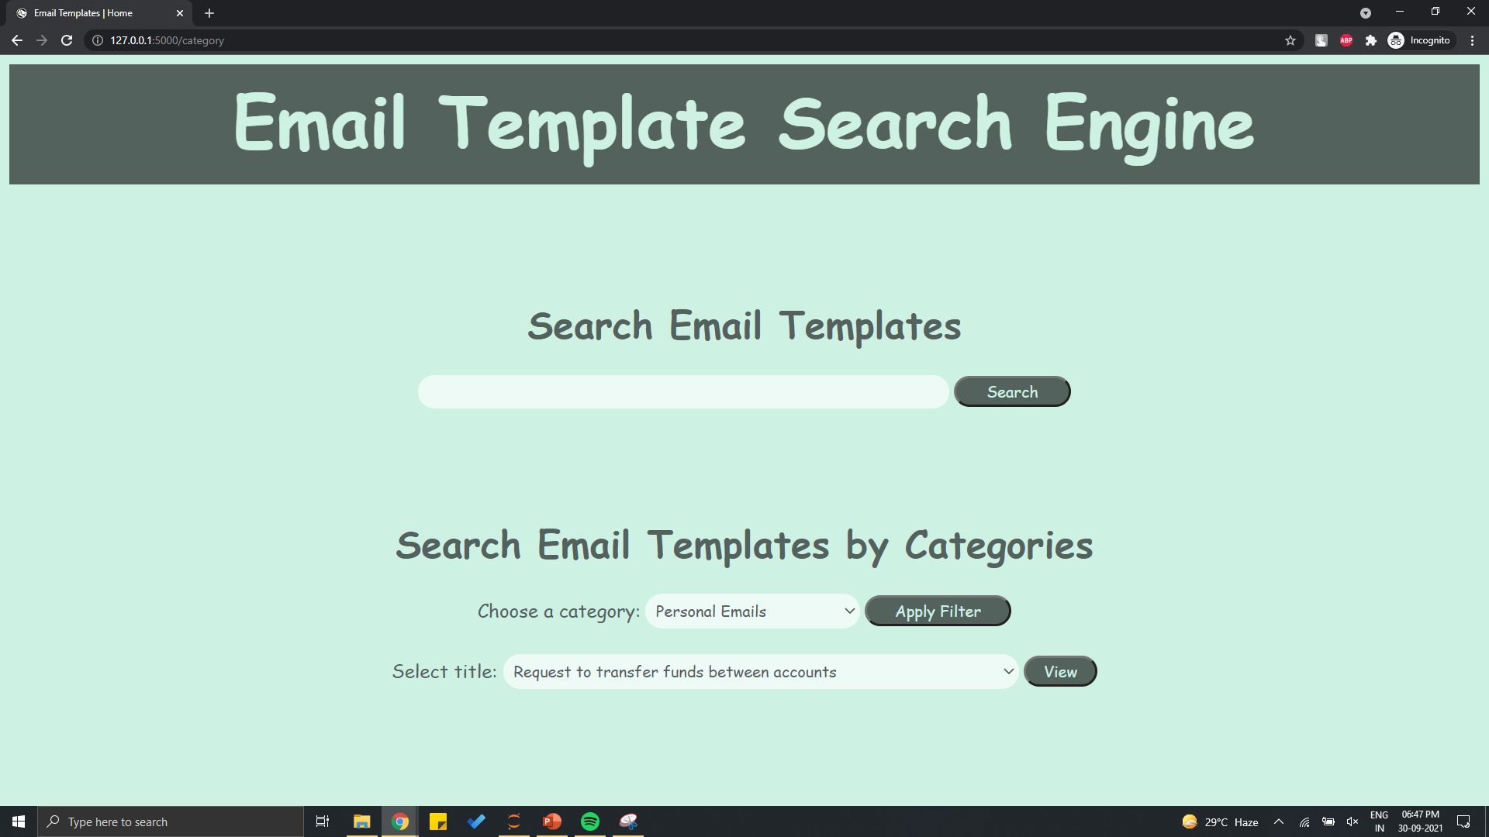
Click View

Slide 41
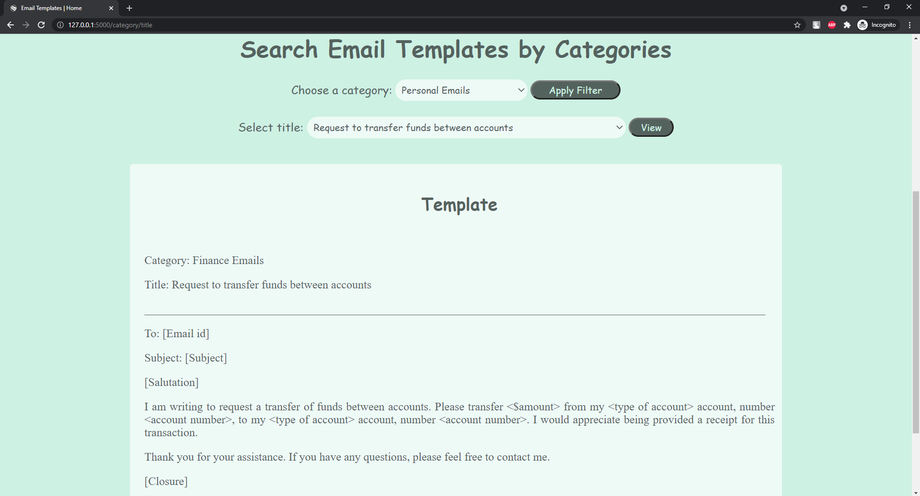
Template is displayed

Slide 42
Challenges
Email Templates in the form of images
Convert Letter templates to Email templates

Slide 43
Future Scope
It can be deployed on cloud services
More templates can be added in the dataset
After deployment search engine can be optimized
Recommendations can be added by mostly searched terms

Slide 44
Thank You!!!

